Slide 1

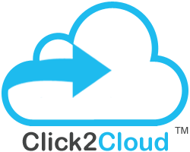



Cloud Migration Technology Company
Click2Cloud Migration Studio
13641, Main St.
Bellevue, WA 98005, USA.
pm@click2cloud.net | + 1 425 749 7495
V-8, Laxmi Nagar,
Nagpur – 440022
contact@click2cloud.net | +91-712-3207999
F2, Beijing Silver Tower, No.2 East 3rd Ring North Road. Chao yang District., Beijing
contact@click2Yun.com | +010-64126268

Slide 2




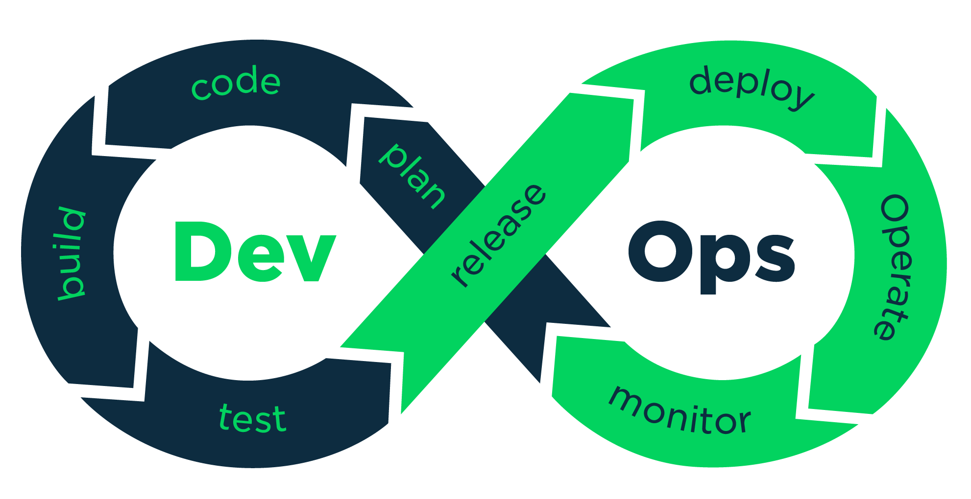















Cloud Compare
DevOps & Cloud Automation
Migration Studio
+
SaaS Model - Self Service Tool
DevOps Studio
Target Cloud
IDE Plugin (VS and Eclipse)
Command line (menu driven)
DockM + ShipM (K8s, Docker)
Source Cloud
On-premise infra.
Cloud Compare Tool – Features
Cloud to Cloud & On-premise to Cloud
Feature Compare
Geographic compare
Cost Compare ($)
Performance Compare
Readiness Compare
Open-Source
Migration Capability
Core Ability (IaaS, PaaS, CaaS)
Click2Cloud Professional Services
Migration Studio
SDK, API & Open-source Automation
PaaS Implementation
Cloud Testing, Support, Maintenances & Training Services
Open Labs
VM, OS Image (ready) migration
Files, Apps, DB & Storage Migration
Legacy app migrations to container
Gap Analysis
Higher Operational Efficiency
Accelerate Cloud Adoption

Slide 3
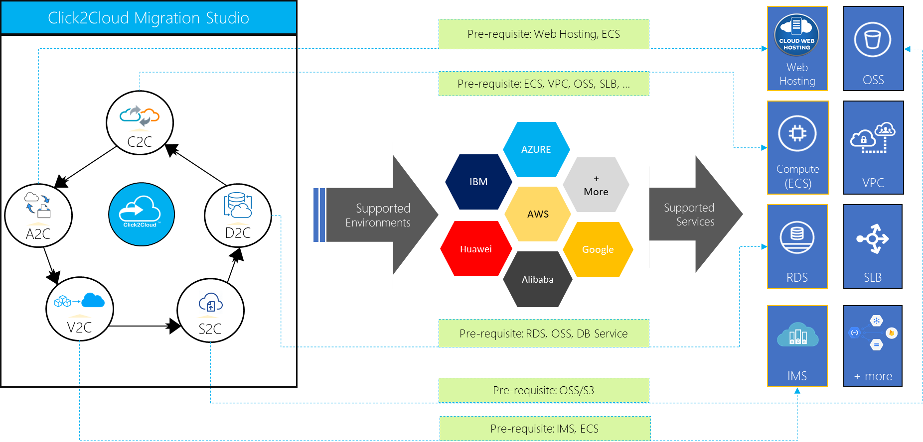
Migration Studio
Click2Cloud Migration Studio is a managed service offering which provides the solutions for various cloud migration needs that includes; database migration, application migration, file migration and virtual machine/bare metal migration. The Click2Cloud migration studio works seamlessly with all the leading cloud providers and associated services.

Slide 4
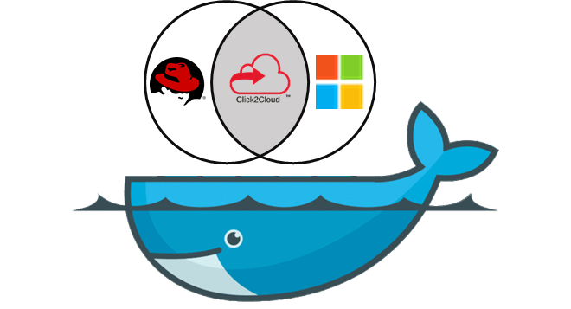
Migration Studio - Features
Cloud to Cloud
Virtual to Cloud
Database to Cloud
Application to Cloud
Storage to Cloud
Cloud Migration Technology Company
Click2Cloud Inc.
contact@click2cloud.net | +1 425 748 9666

Slide 5
C2C
Cloud to Cloud Migration
Key Feature: Migrate cloud Instances (compute workload) from source clouds to destination clouds
Cloud Migration Technology Company
Click2Cloud Inc.
contact@click2cloud.net | +1 425 748 9666

Slide 6

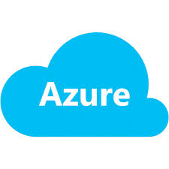










Cloud to Cloud – Migration Architecture
Top Cloud Providers
Destination Clouds
AWS
Azure
Google
User’s Workstation
ECS Instances
1
3
Config file
C2C Migration
Tool
2
Huawei Cloud SDK
Cloud SDK
OSS
Image Service
ECS
Click2Cloud Automation
Alibaba
Huawei
Clouds
Click2Cloud will assist to build
1
2
3
C2C Migration Tool; to help end users to migrate the images/VMs/ECS instances
Click2Cloud Automation Tools; to perform advance level tasks like instances provisioning
Cloud SDK for different programing languages such as Python, Ruby, Go, .NET, Java etc.
© Copyright 2017 Click2Cloud Inc.

Slide 7
V2C
Virtual to Cloud Migration
Key Feature: Migrate on-premise Instances from source virtualization platform like Hyper-V, VMware, etc. to destination clouds
Cloud Migration Technology Company
Click2Cloud Inc.
contact@click2cloud.net | +1 425 748 9666

Slide 8
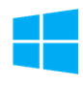
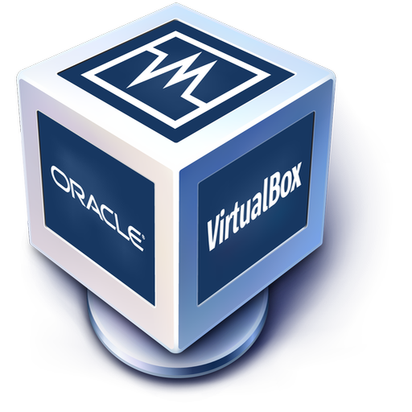
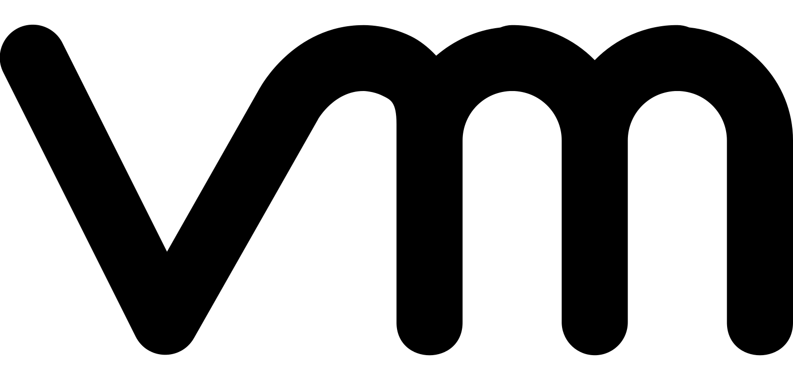


Virtual to Cloud – Migration Architecture
Any Virtualization Software
Destination Clouds
Hyper-V
VBox
VMWare
User’s Workstation
ECS Instances
1
3
Config file
C2C Migration
Tool
2
Huawei Cloud SDK
Cloud SDK
OSS
Image Service
ECS
Click2Cloud Automation
On-Premise
Local VHD
Any Infrastructure Location
Click2Cloud will assist to build
1
2
3
C2C Migration Tool; to help end users to migrate the images/VMs/ECS instances
Click2Cloud Automation Tools; to perform advance level tasks like instances provisioning
Cloud SDK for different programing languages such as Python, Ruby, Go, .NET, Java etc.
© Copyright 2017 Click2Cloud Inc.

Slide 9
A2C Application to Cloud Migration
Key Feature: Migrate applications from on-premise servers or source repositories like Github, Bitbucket, etc. to destination cloud Instances or Web Hosting services
Cloud Migration Technology Company
Click2Cloud Inc.
contact@click2cloud.net | +1 425 748 9666

Slide 10

Application to Cloud – Migration Architecture
Source Web Applications
Destination Clouds
Web Hosting
User’s Workstation
1
3
ECS (Application)
GitHub / Bitbucket
Web Hosting
C2C Migration
Tool
Cloud SDK
C2C Config file
2
Huawei Cloud SDK
FTP
ECS (Applications)
Local /
On-premise
Click2Cloud Automation
Click2Cloud will assist to build
1
2
3
C2C Migration Tool; to help end users to migrate there web application to cloud
Click2Cloud Automation Tools; to perform advance level tasks like instances provisioning
Cloud SDK for different programing languages such as Python, Ruby, Go, .NET, Java etc.
© Copyright 2017 Click2Cloud Inc.

Slide 11
S2C Storage to Cloud Migration
Key Feature: Migrate Storage data/objects from source cloud storages like S3, OSS, OBS, Blobs, etc. to destination clouds storage
Cloud Migration Technology Company
Click2Cloud Inc.
contact@click2cloud.net | +1 425 748 9666

Slide 12



Storage to Cloud – Migration Architecture
Cloud Storage Services
Destination Clouds
AWS S3
Azure Blob
Google Storage
User’s Workstation
Storage Buckets
1
3
Config file
C2C Migration
Tool
2
Huawei Cloud SDK
Cloud SDK
Cloud Storage Service
Click2Cloud Automation
Alibaba OSS
Huawei OBS
Storage’s
Click2Cloud will assist to build
1
2
3
C2C Migration Tool; to help end users to migrate the storage data from source cloud to destination cloud
Click2Cloud Automation Tools; to perform advance level tasks
Cloud SDK for different programing languages such as Python, Ruby, Go, .NET, Java etc.
© Copyright 2017 Click2Cloud Inc.

Slide 13
D2C
Database to Cloud Migration
Key Feature: Migrate on-premise database like MSSQL, MYSQL, etc to destination clouds database services
Cloud Migration Technology Company
Click2Cloud Inc.
contact@click2cloud.net | +1 425 748 9666

Slide 14
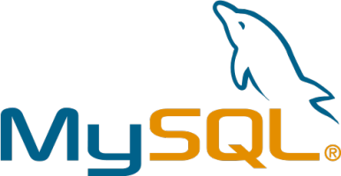
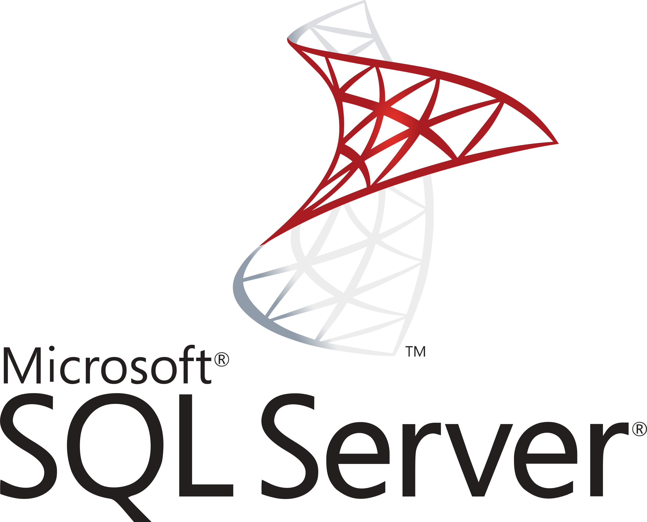
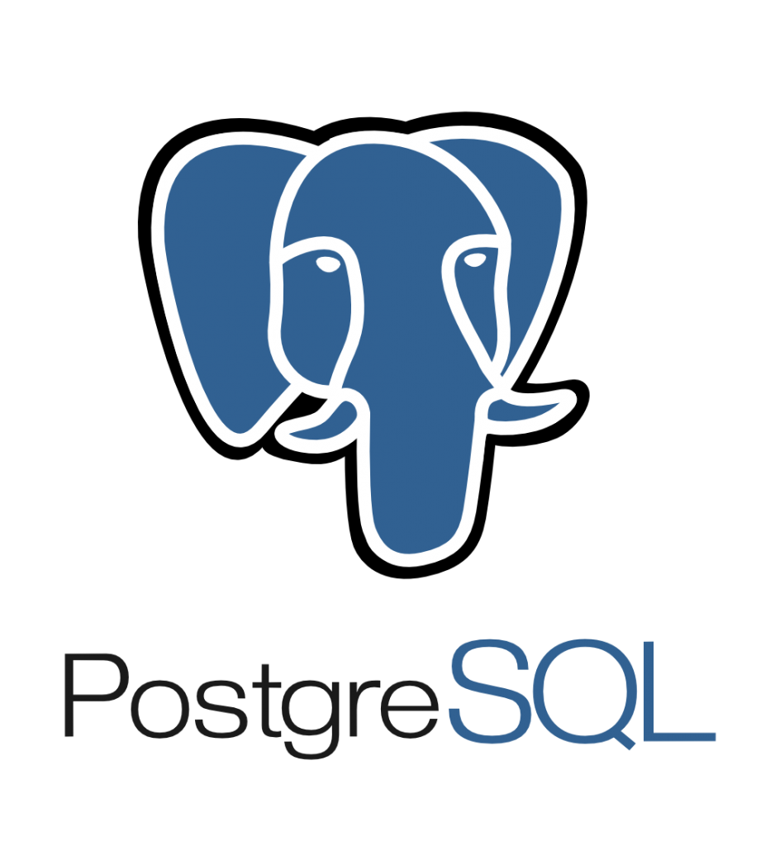


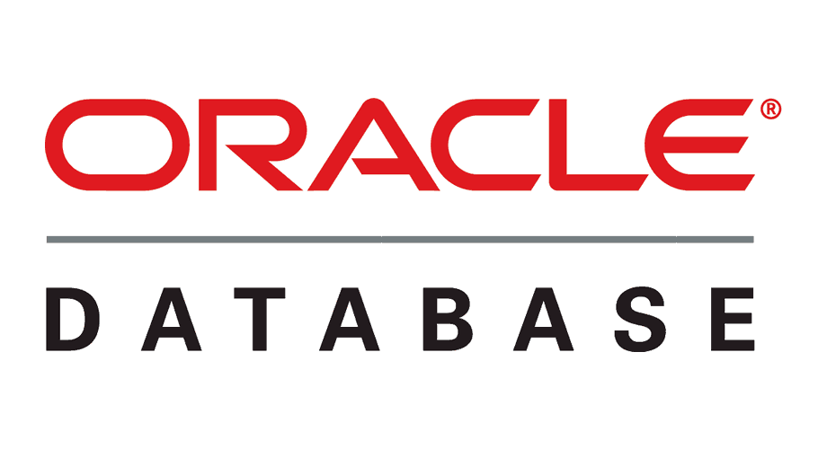
Database to Cloud – Migration Architecture
Database Environment
Destination Cloud Environment
MySQL
MSSQL
PostgreSQL
User’s Workstation
1
3
Config file
RDS Instances
C2C Migration
Tool
2
Huawei Cloud SDK
Cloud SDK
RDS Service
Click2Cloud Automation
MongoDB
Oracle DB
Click2Cloud will assist to build
1
2
3
C2C Migration Tool; to help end users to migrate the Database instances/RDS
Click2Cloud Automation Tools; to perform advance level tasks like instances provisioning
Cloud SDK for different programing languages such as Python, Ruby, Go, .NET, Java etc.
© Copyright 2017 Click2Cloud Inc.
© Copyright 2017 Click2Cloud Inc.

Slide 15
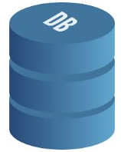
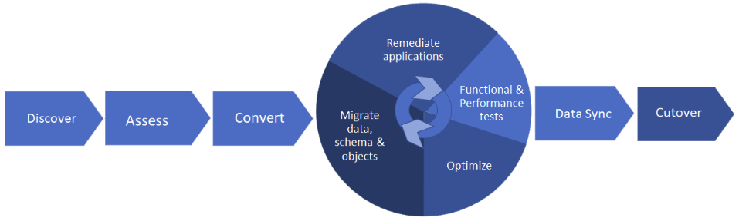
Database to Cloud – Migration Architecture
Source Environment
Target Environment
Data Staging and Test Environment
Database asset inventory, Workload assessment and recommended fixes.
Conversion of source schema to target environment
Migration of data to the target environment.
Performs testing to confirm functionality and performance
Cloud Migration Technology Company
Click2Cloud Inc.
contact@click2cloud.net | +1 425 748 9666

Slide 16
Data Migration
Functional Process:
l
Scope Identification – Identify the data objects and data, for each object that need to be migrated
Data Mapping – Map the data from source to target objects. In case source and target have different data models, transformation and mapping would be essential for migration.
Option Selection – Identify the migration option suitable, as per system needs, such as the time taken and target DB, as well as data needs like transformation and volume.
Migration – Perform data migration to the destination system using the selected solution.
Validation – Perform audits, validations, and acceptance tests to validate and certify data at destination.
Cloud Migration Technology Company
Click2Cloud Inc.
contact@click2cloud.net | +1 425 748 9666

Slide 17
Key Features of Data Migration Tool
Flexible and scalable system : Simple and Scalable Methodology for Moving Legacy Applications
Security : Provides secured data transfer for sensitive information such as User and Password. (ex. Encryption can be done)
Cost Effectiveness : Lower deployment and maintenance costs (no additional cost)
Performance : Save time with an easy-to-use solution and migrate data continuously with zero downtime
Helps in Distributed Development
Automated Cloud Network Mapping, Workload Optimization, and Management
Comprehensive Protection of Data in Transit and at Rest
Preserve Data Quality, Data Cleansing, Deduping, and Compression
Support transaction integrity to avoid data consistency issues
Cloud Migration Technology Company
Click2Cloud Inc.
contact@click2cloud.net | +1 425 748 9666

Slide 18
Benefits of Data Migration Tool
Improved corporate performance
Increased competitive advantage
Efficient and effective business processes
Reduced uncertainty and risk
Lower costs of iterations and rewriting code and Reduced unexpected costs
Reduced delays and wasted time
A measurable and accurate view of data
Improved customer service
Better accountability and ability to meet compliance targets
Additional value for shareholders and stakeholders
Cloud Migration Technology Company
Click2Cloud Inc.
contact@click2cloud.net | +1 425 748 9666

Slide 19
Thank you - Looking forward to hear your quires
At Click2Cloud Inc., we care about your growth. We combine the most suitable technologies with intellect and expertise to help customers meet their swiftly changing needs of global business models and dynamic requirements for sophisticated technology solutions to meet their business requirements.
Click2Cloud Headquarters
Click2Cloud India Office
Click2Cloud China Office
2549 152nd NE Ave, Redmond 98052, WA USA
Phone: +1-425-748-9666
Email: contact@click2cloud.net
Website: www.click2cloud.net
3, STPI, Building,
Parsodi IT Park, Nagpur - 440022
Phone: +91-712-224-8747 /
+1 425 749 7495
Email: contact@click2cloud.net
Website: www.click2cloud.net
F2, Beijing Silver Tower, No.2 East 3rd Ring North Road. Chao yang District., Beijing
Ph: 130 23185971 / 131 62780929
Email: contact@click2yun.com
Website: www.click2yun.com
Cloud Migration Technology Company
Click2Cloud Inc.
contact@click2cloud.net | +1 425 748 9666
Notes:
Presentation for Graph + Details

